Slide 1
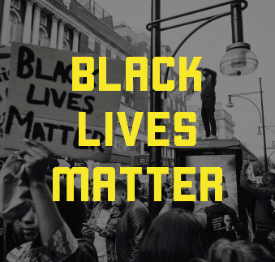
What do you think this means?
Have you seen or heard anything recently about the Black Lives Matter Movement?

Slide 2
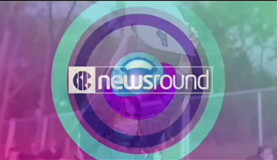

Slide 3

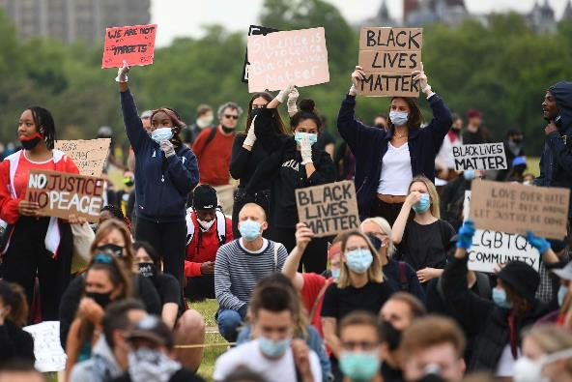
Do you recognise what this Newsround report is about?
Have you heard about the Black Lives Matter movement?

Slide 4
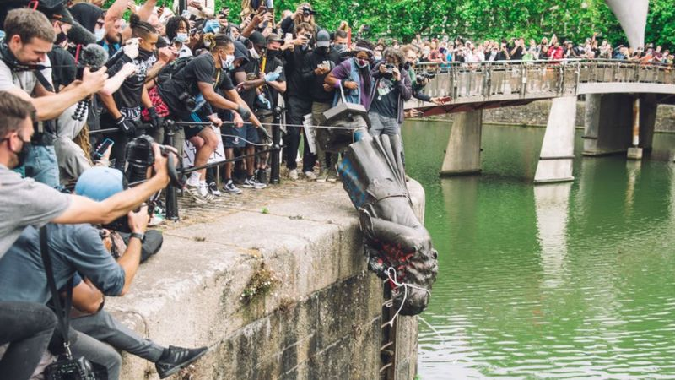
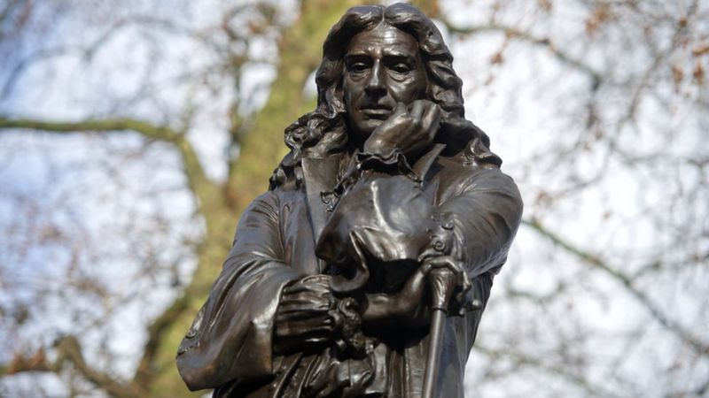
What’s been happening in Bristol?
Why do you think protesters tore down the statue?
How do you feel about the statue being torn down? Discuss with an adult at home.

Slide 5

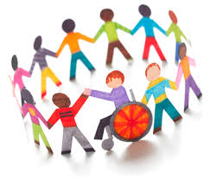
What is equality?
Equality is one of our school values.
It means that everyone should be treated the same regardless of the colour if their skin, what they look like or where they are from.
It is important everyone is treated the same by everyone in our community.

Slide 6
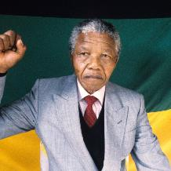
What can we do to help promote equality in our community?
You have the next 3-4 minutes to discuss/think/write down any ways or things that you think you can do to help tackle racism.
“Education is the most powerful weapon which you can use to change the world.” Nelson Mandela former South African President.

Slide 7

What can YOU read?
Ask an adult to click this link for an anti-racism children’s book list.

Slide 8
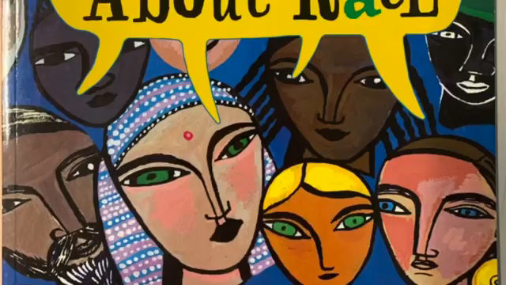
Here is a story called ‘Let’s talk about race’

Slide 9
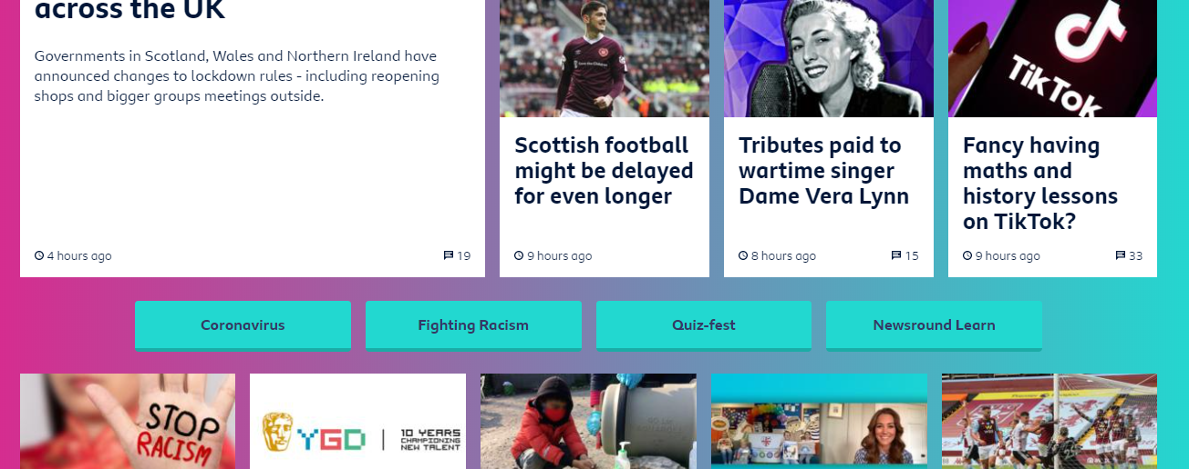
If you want to read more:
Link to Newsround:
https://www.bbc.co.uk/newsround
Scroll down to where it says ‘fighting racism’

Slide 10
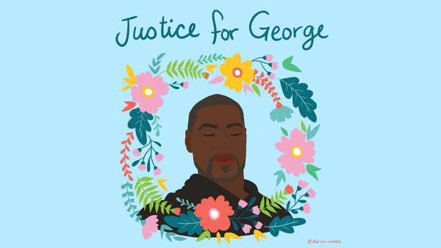
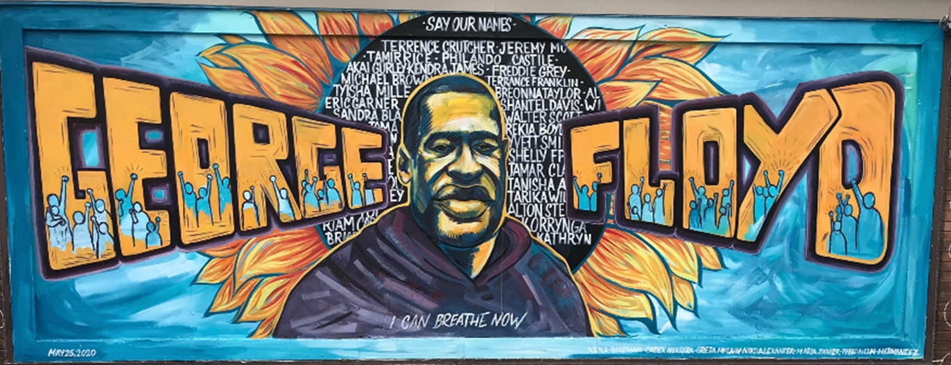
What you can do:
Your task. Choose from one of the following:
Research about important people in Black history. Is there somebody who from history that should have a statue made of them to go in the place of the Edward Colston statue? Describe why you have chosen this person.
Think about what equality means to you. Create a design for a sculpture to represent equality that can go in the place of Edward Colstons statue.

